Slide 1

Azure App Service
Abdul Rasheed Feroz Khan
@TechFero | @CodeSizzler
feroz@cwtechnologies.in

Slide 2
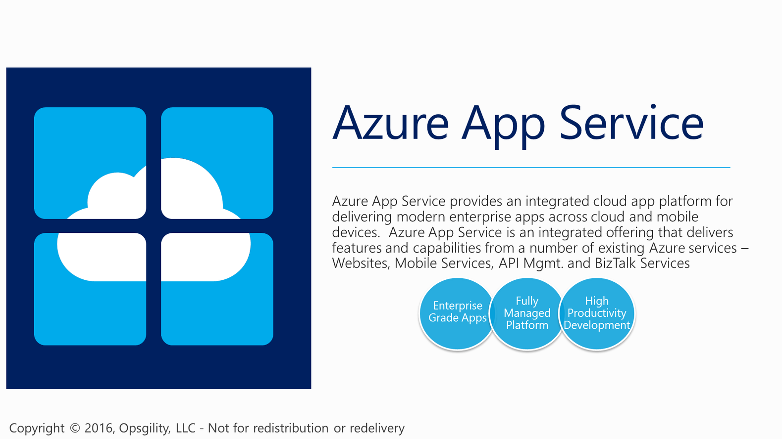
Notes:
API App – Deploy your own APIs into this offering to host and expose them for use with you custom applications
Logic App - Logic Apps provide a way to simplify and implement scalable integrations and workflows in the cloud. It provides a visual designer to model and automate your process as a series of steps known as a workflow. A logic app begins with a trigger (like 'When an account is added to Dynamics CRM') and after firing can begin many combinations actions, conversions, and condition logic.

Slide 3
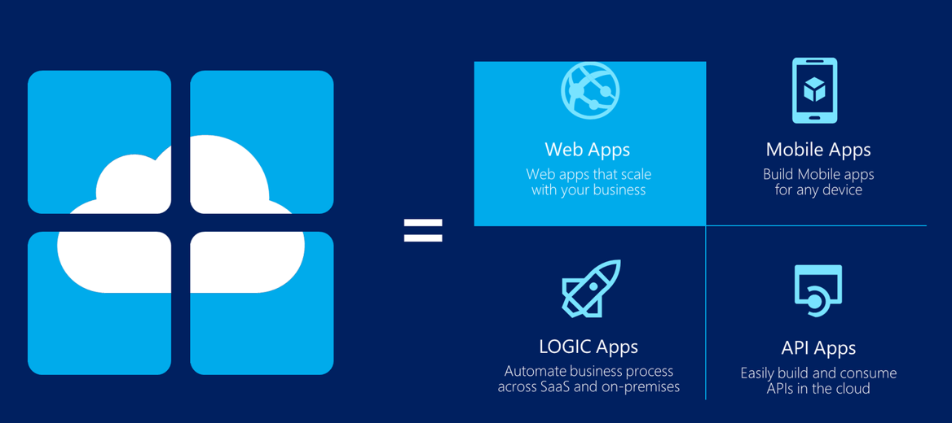

Slide 4
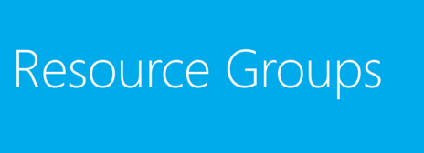

Slide 5
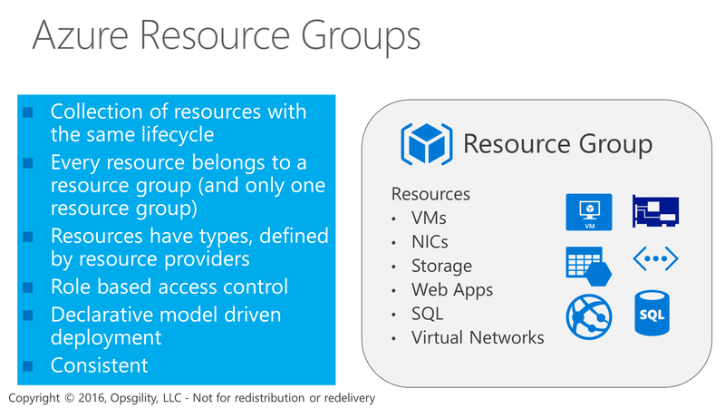
Azure Resource Groups
Notes:
Azure resource groups are a logical container that can span regions used to contain resources into groups that share a common life cycle.
Resources within a resource group can be created, updated, and deleted as a group.
What are resource Type - Each resource provider offers a set of resources and operations for working with an Azure service. For example, if you want to store keys and secrets, you work with the Microsoft.KeyVault resource provider. This resource provider offers a resource type called vaults for creating the key vault, and a resource type called vaults/secrets for creating a secret in the key vault.

Slide 6
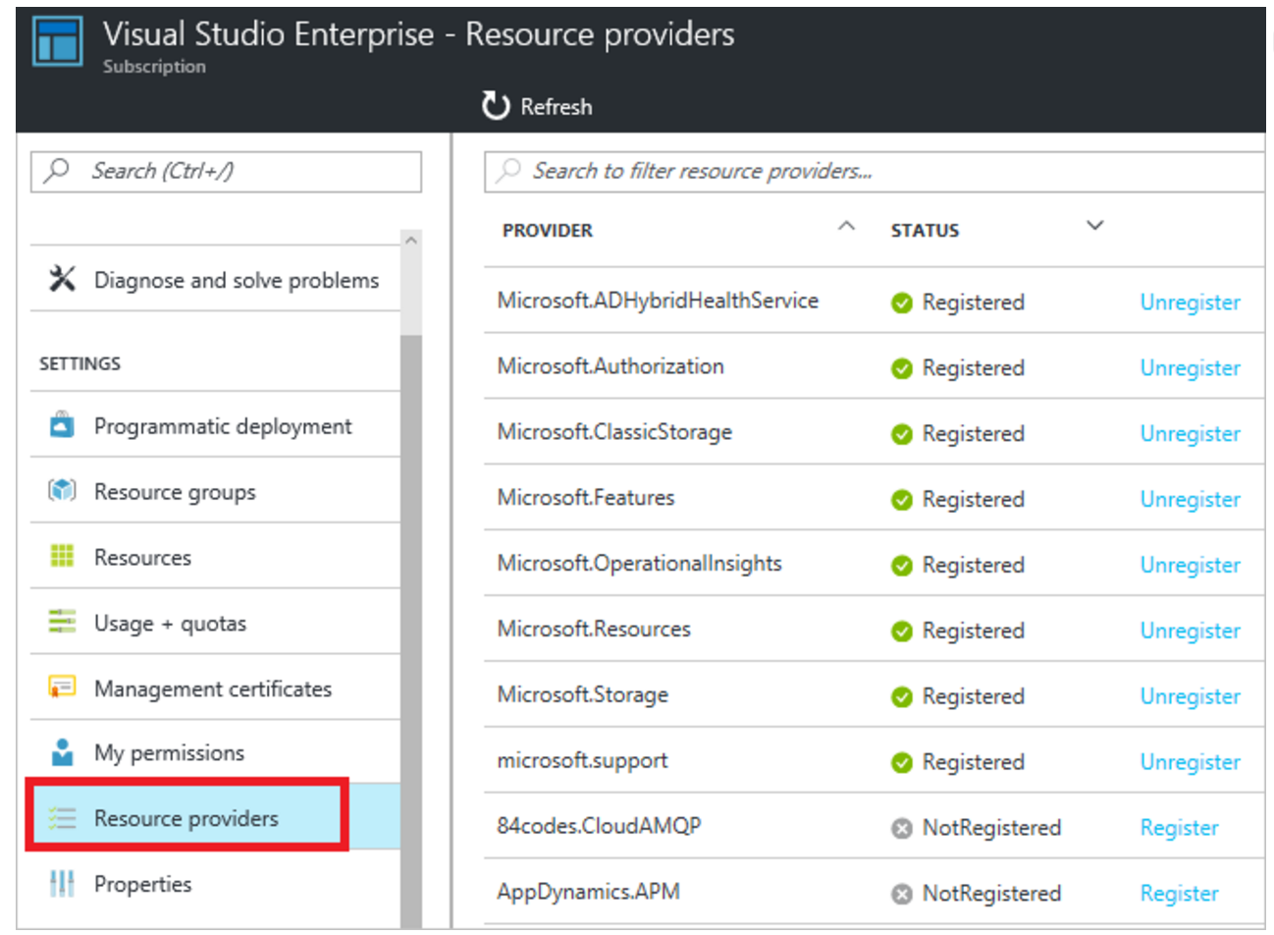

Slide 7
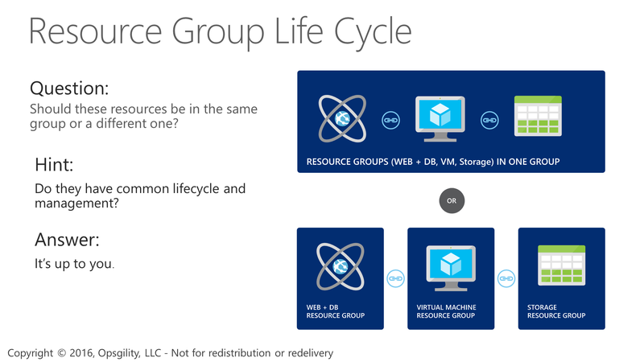
Resource Group Life Cycle
Notes:
Azure Resources should be grouped by Life Cycle, but really at the end of the day its up to the administrators or developers to decide how to use RGs. The real management implications are also very important since the RG is a security boundary when using Role Based Access Control.

Slide 8
Demo 1– PaaS based Web APP on Azure

Slide 9
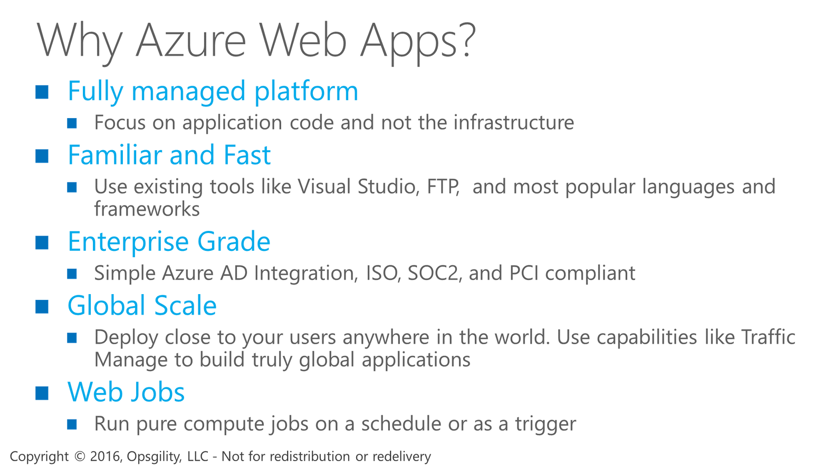
Why Azure Web Apps?
Notes:
You can run programs or scripts in WebJobs in your App Service web app in three ways: on demand, continuously, or on a schedule.
Azure Functions is another way to run programs and scripts in Azure App Service.
Web Jobs can be used to support Web, API, and Mobile apps

Slide 10
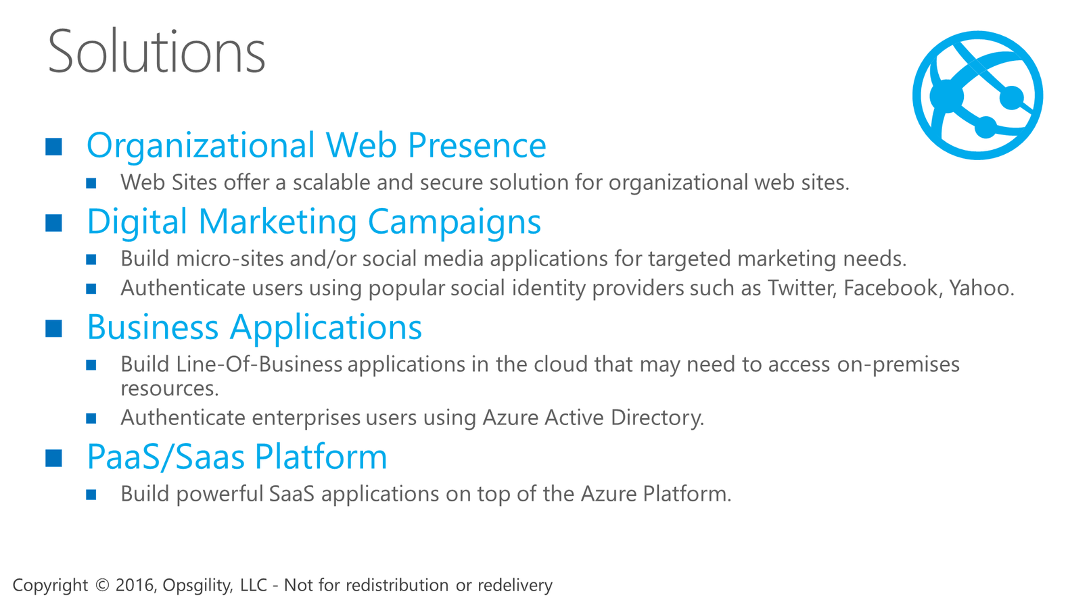
Solutions

Slide 11
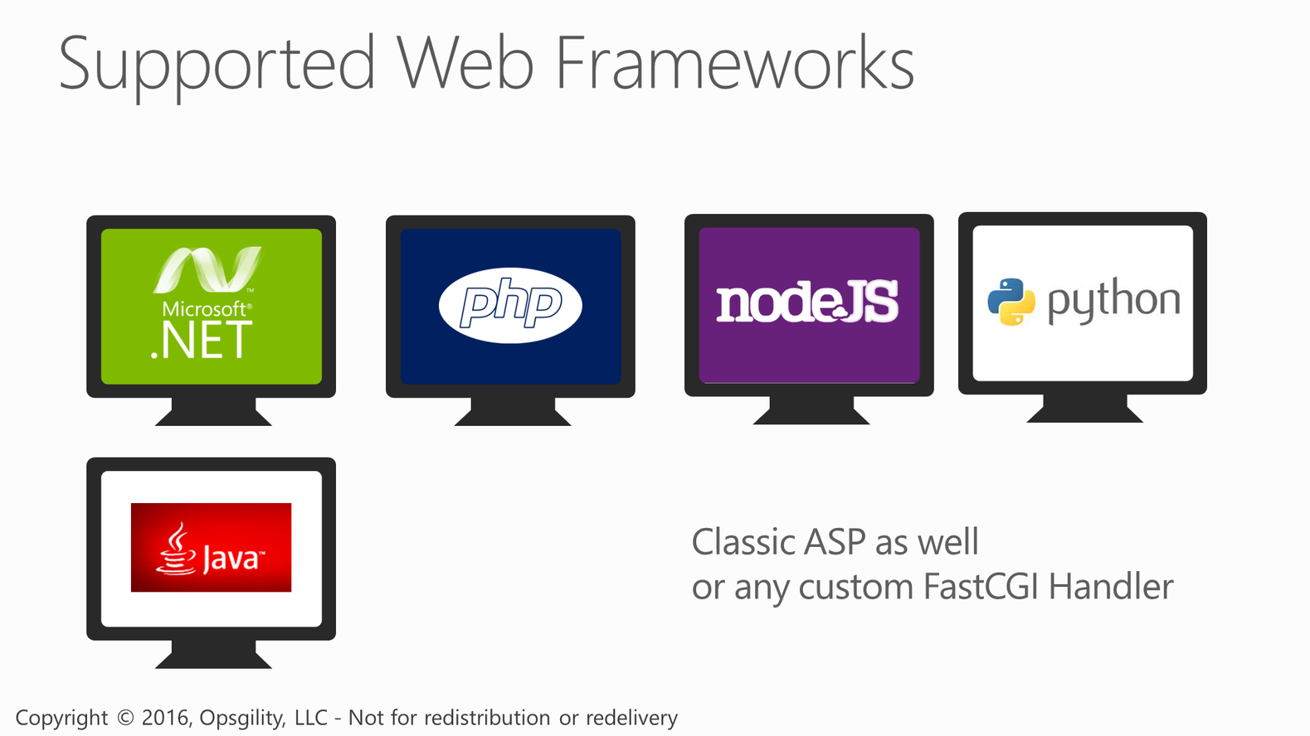
Supported Web Frameworks
Notes:
With websites you can deploy applications built on Classic ASP, ASP.NET, PHP, Python, Java, and Node.js. You do not have to worry about the runtime itself because it is built in to the platform.
Any framework that supports using the FastCGI handler in IIS is also supported.

Slide 12
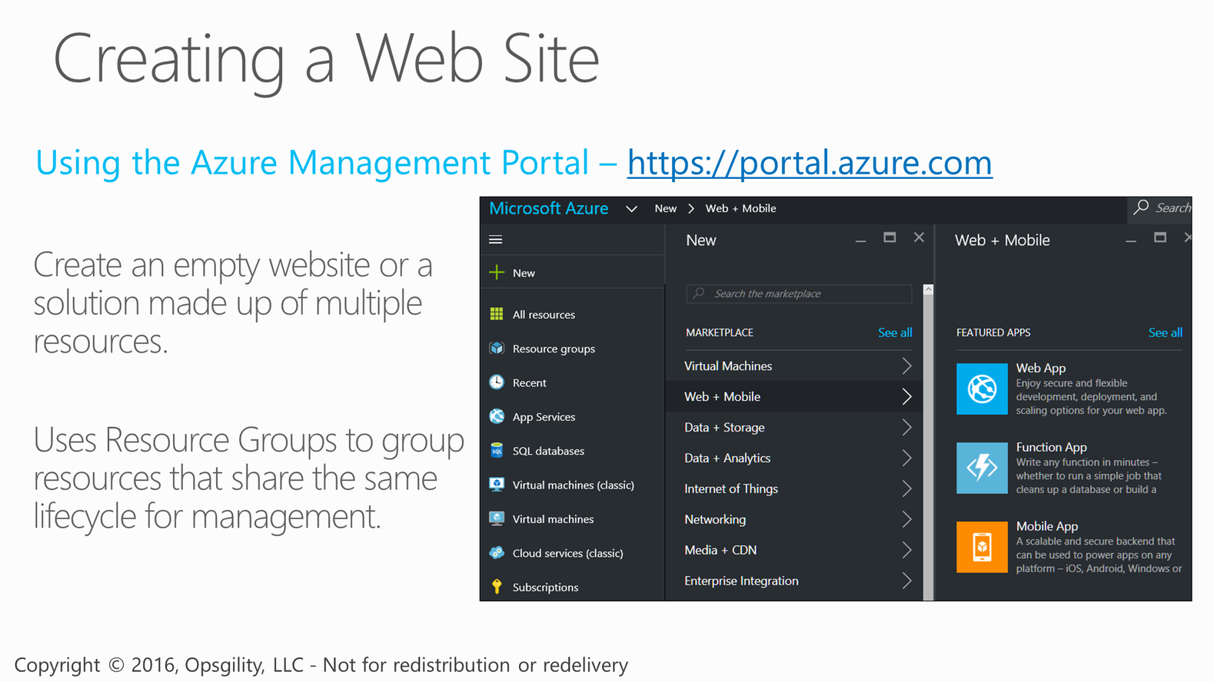
Creating a Web Site

Slide 13
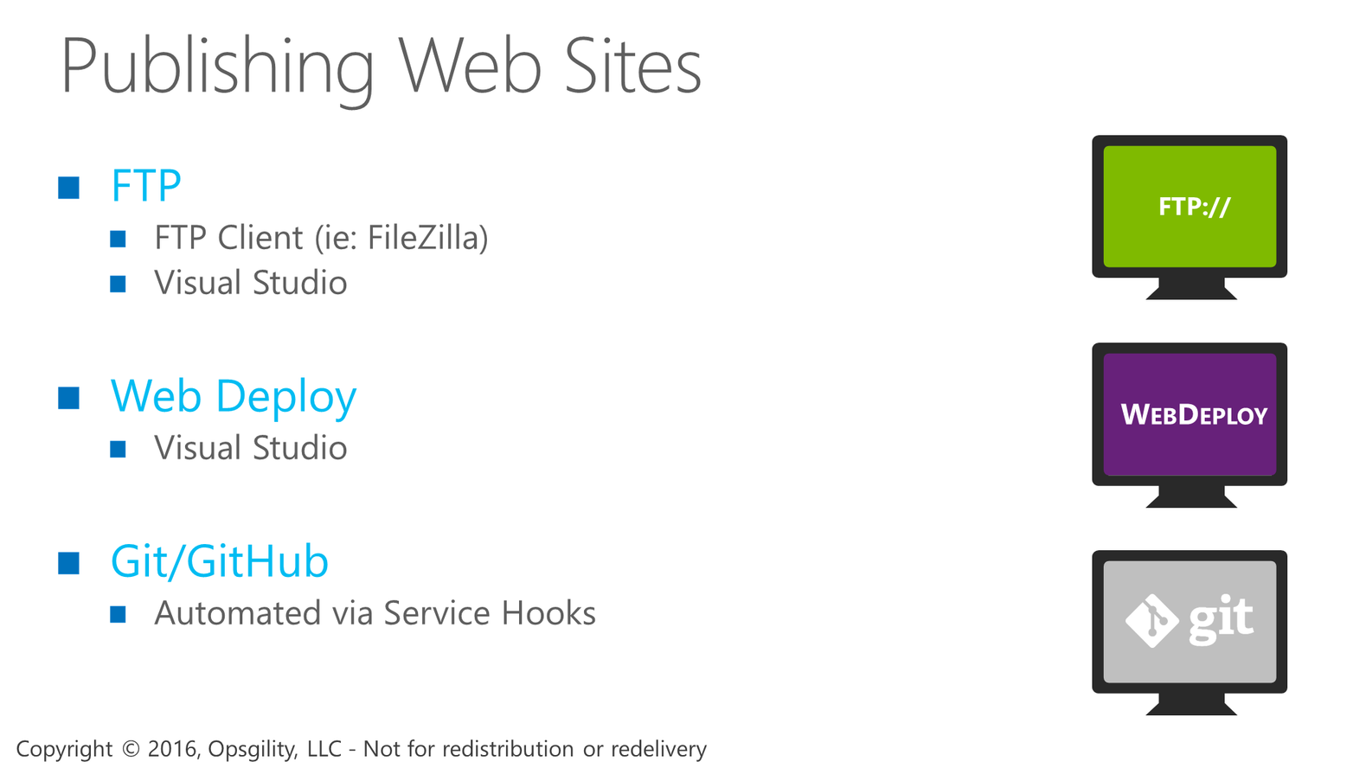
Publishing Web Sites

Slide 14
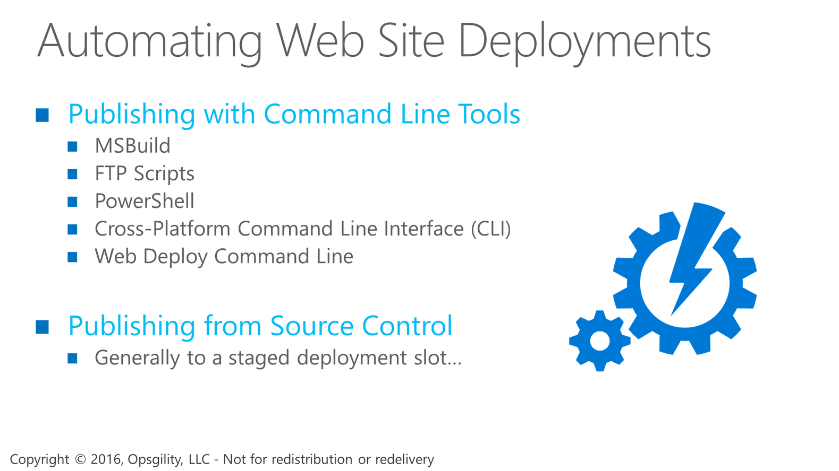
Automating Web Site Deployments

Slide 15
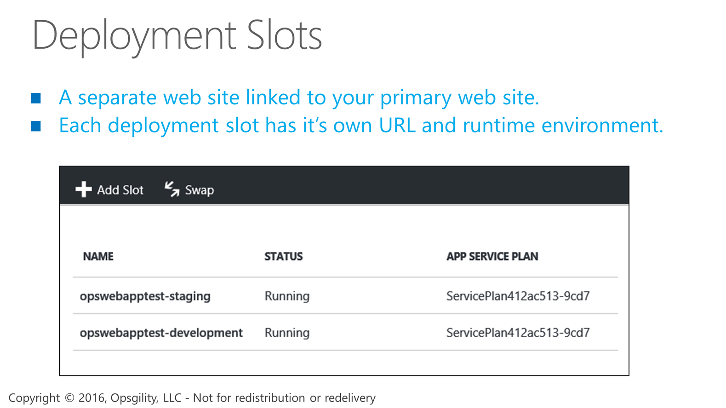
Deployment Slots

Slide 16
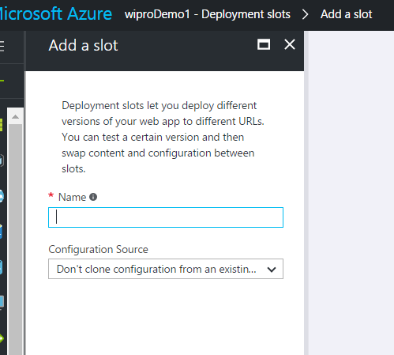

Slide 17
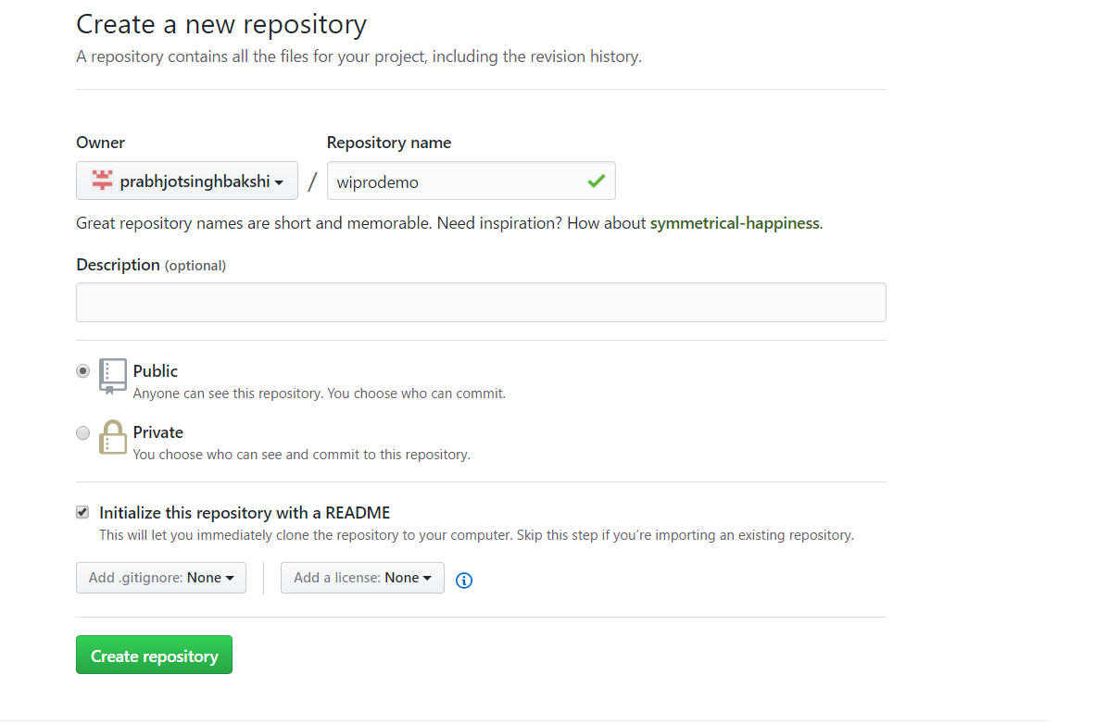

Slide 18
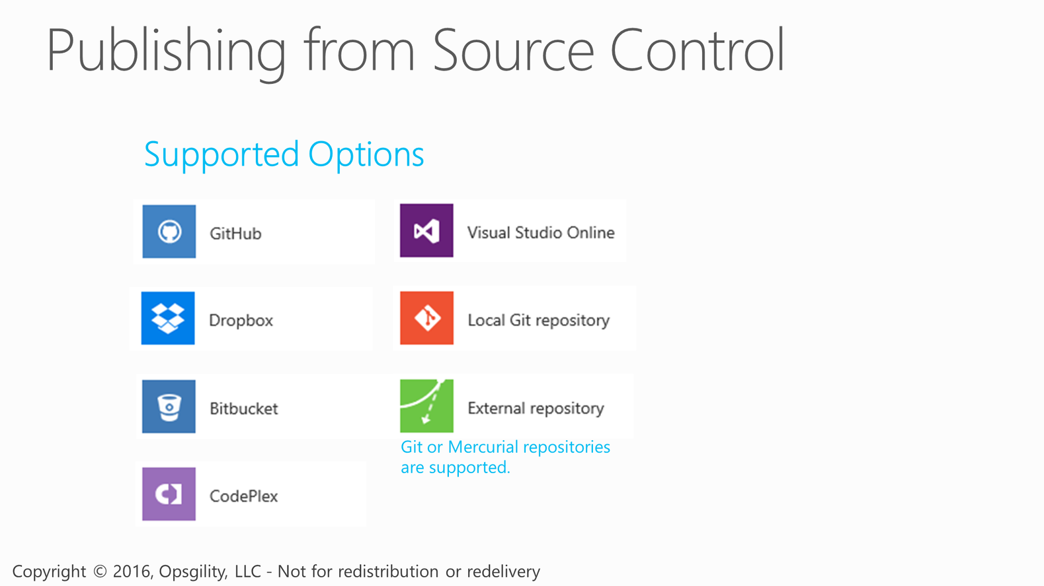
Publishing from Source Control
Notes:
Website deployment is all about being agile and flexible. Whether you just want to simply FTP your content for deployment or deploy with more advanced continuous integration using applications like TFS, WebDeploy, Git or even dropbox there are plenty of options.
GitHub, CodePlex and BitBucket are also supported using a Git service hook.
Windows Azure Websites have recently introduced the concept of a staging site and a swap feature. Similar to cloud services you can also deploy to staging, verify the new deployment is valid and then swap to production.

Slide 19
Demo 2- Deployment Slot with Github

Slide 20
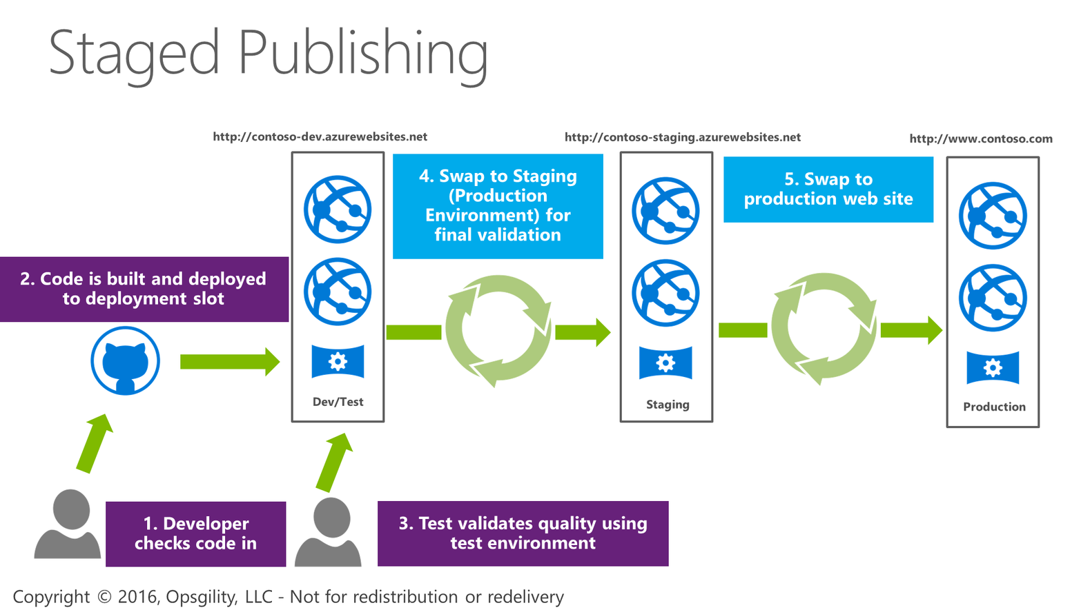
Staged Publishing

Slide 21
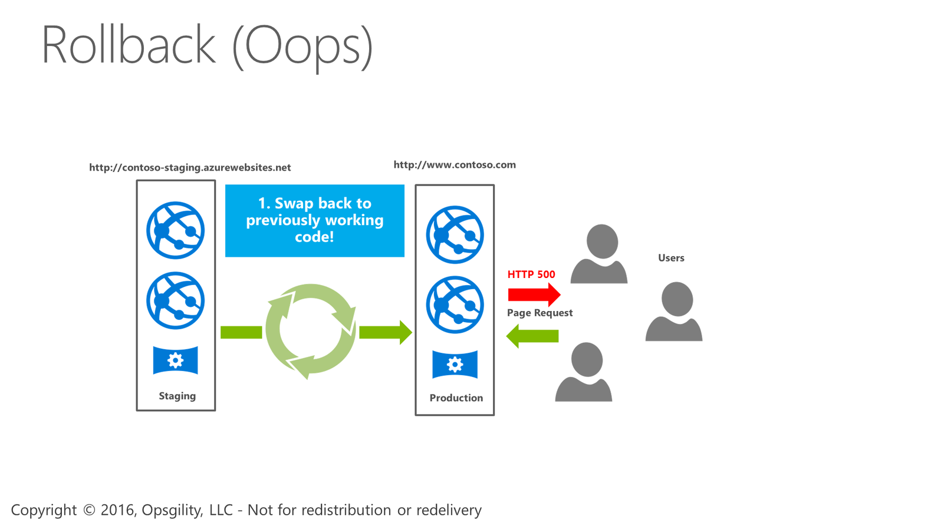
Rollback (Oops)

Slide 22
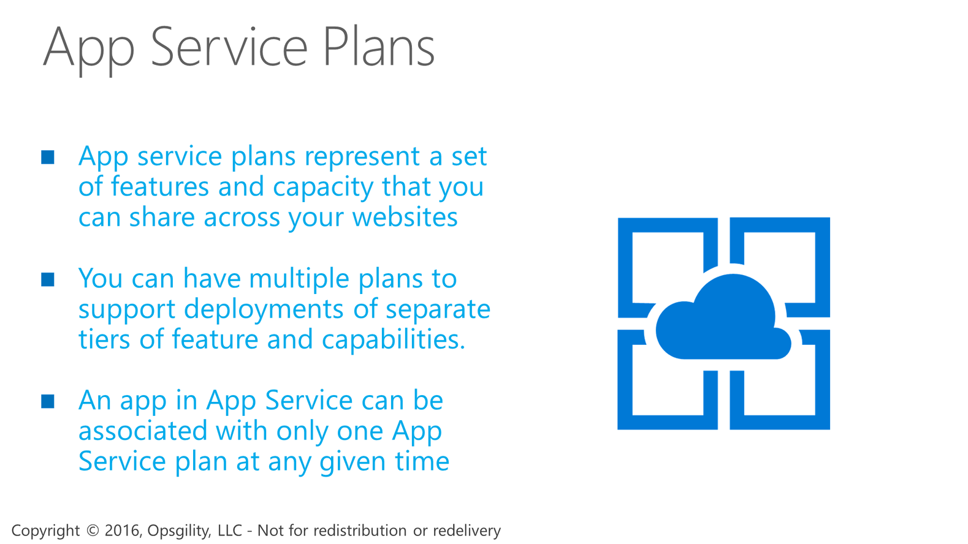
App Service Plans

Slide 23
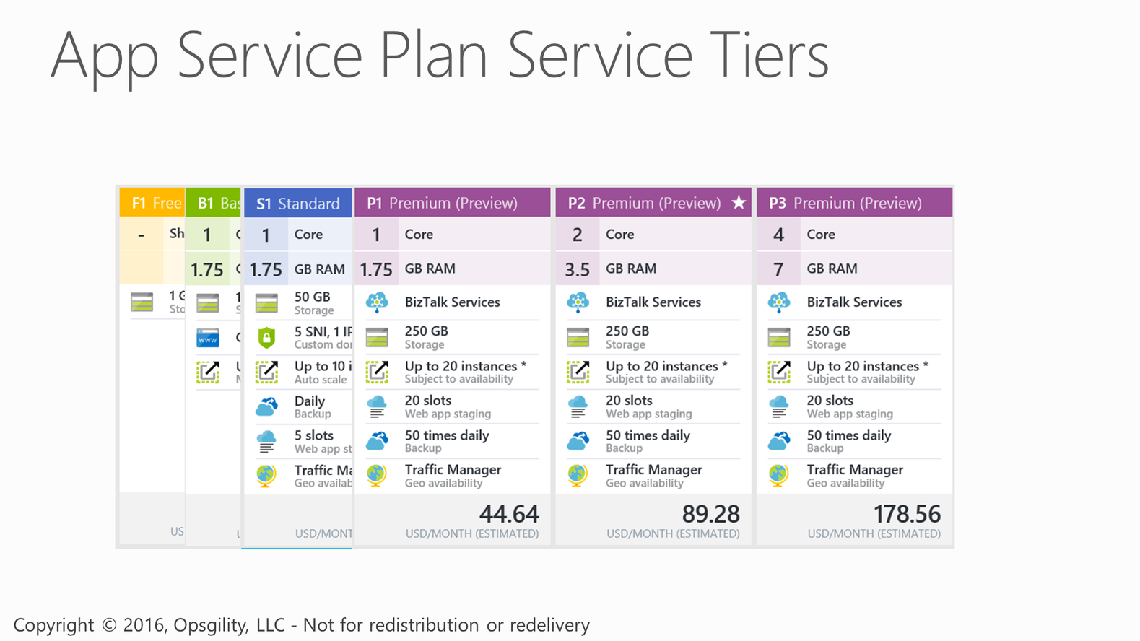
App Service Plan Service Tiers

Slide 24
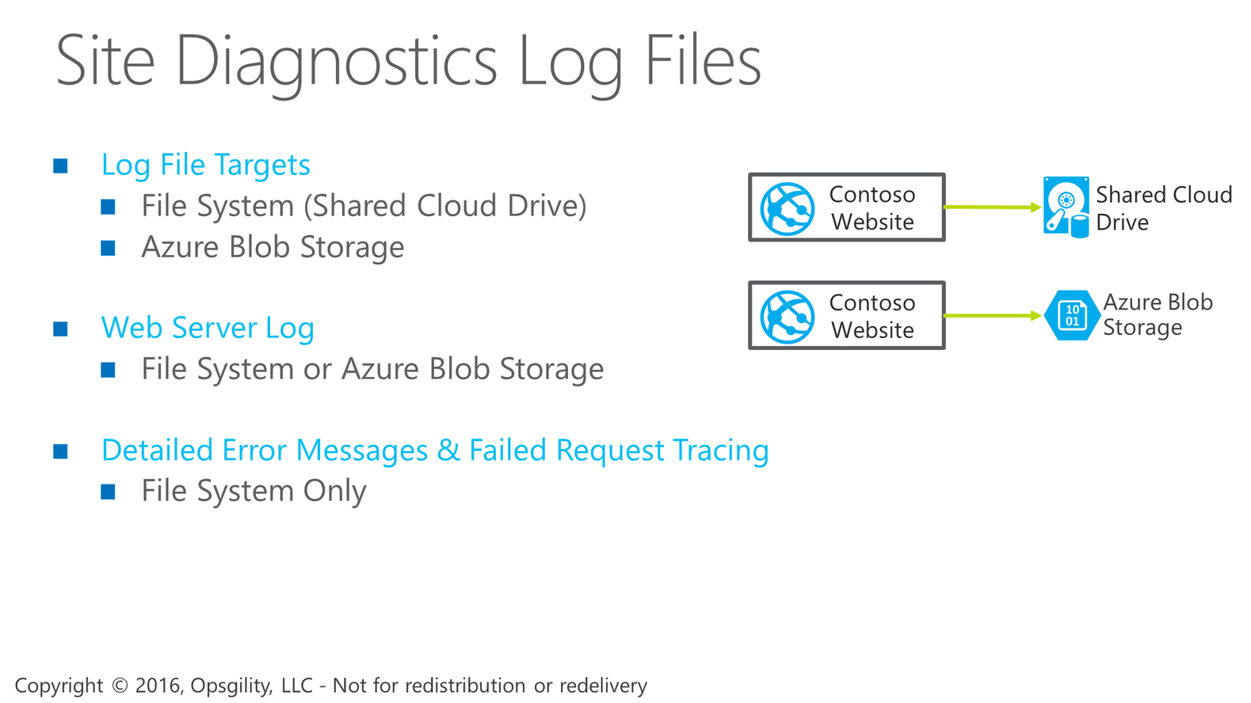
Site Diagnostics Log Files
Notes:
App Service web apps provide diagnostic functionality for logging information from both the web server and the web application. These are logically separated into web server diagnostics and application diagnostics.

Slide 25
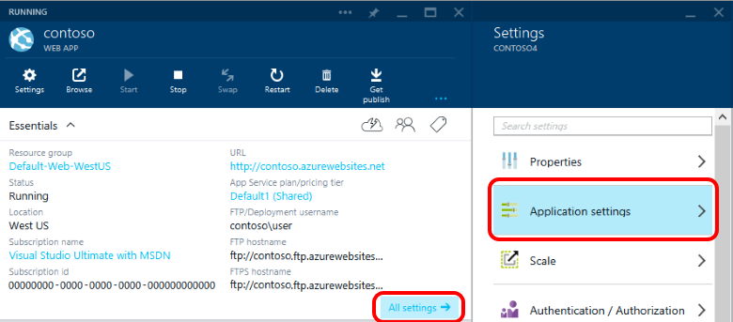
Custom configuration and application settings in Azure Web Sites ...

Slide 26
Demo 3- Application settings and Configuration

Slide 27
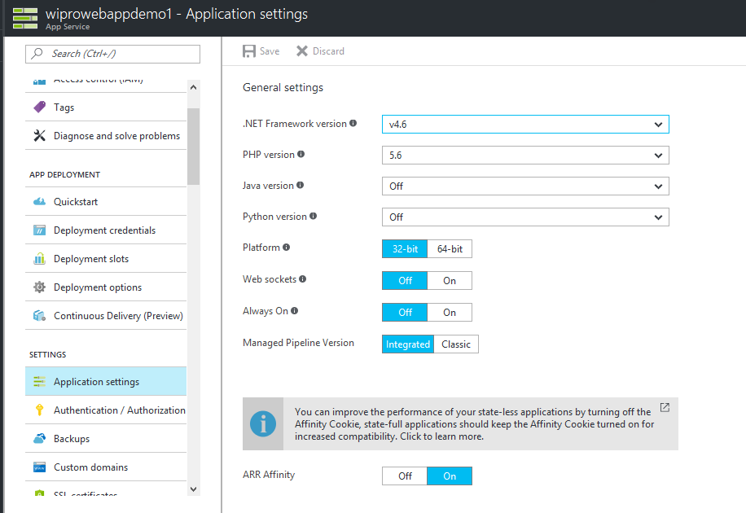
Notes:
Web Sockets. Set ON to enable the WebSocket protocol; for example, if your web app uses ASP.NET SignalR or socket.io.
Always On. By default, web apps are unloaded if they are idle for some period of time. This lets the system conserve resources. In Basic or Standard mode, you can enable Always On to keep the app loaded all the time. If your app runs continuous web jobs, you should enable Always On, or the web jobs may not run reliably.
Managed Pipeline Version. Sets the IIS pipeline mode. Leave this set to Integrated (the default) unless you have a legacy app that requires an older version of IIS.
Auto Swap. If you enable Auto Swap for a deployment slot, App Service will automatically swap the web app into production when you push an update to that slot.

Slide 28
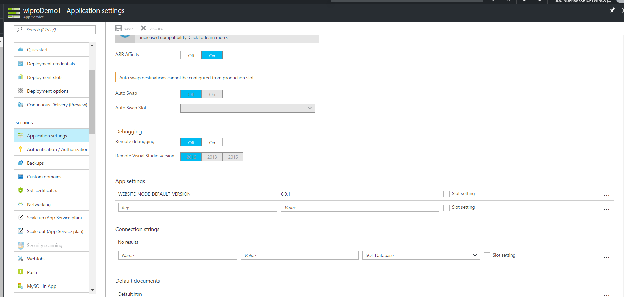
Notes:
Remote Debugging. Enables remote debugging. When enabled, you can use the remote debugger in Visual Studio to connect directly to your web app. Remote debugging will remain enabled for 48 hours.
App settings
This section contains name/value pairs that you web app will load on start up. For .NET apps, these settings are injected into your .NET configuration AppSettings at runtime, overriding existing settings. PHP, Python, Java and Node applications can access these settings as environment variables at runtime.
Connection strings for linked resources.
For .NET apps, these connection strings are injected into your .NET configuration connectionStrings settings at runtime, overriding existing entries where the key equals the linked database name.
For PHP, Python, Java and Node applications, these settings will be available as environment variables at runtime, prefixed with the connection type.

Slide 29
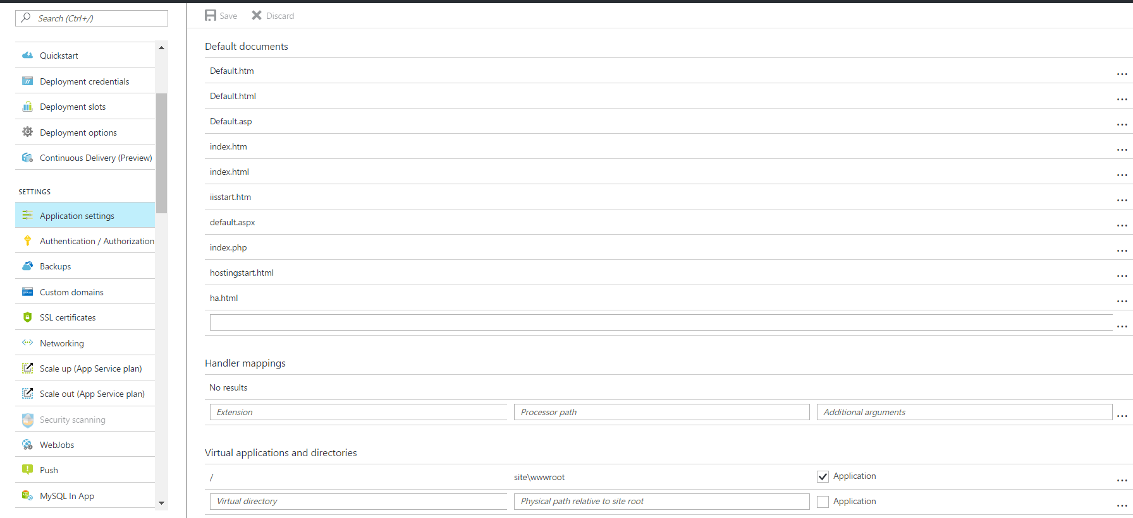
Notes:
Default documents
The default document is the web page that is displayed at the root URL for a website. The first matching file in the list is used
Handler mappings
Use this area to add custom script processors to handle requests for specific file extensions. Extension. The file extension to be handled, such as *.php or handler.fcgi.

Slide 30
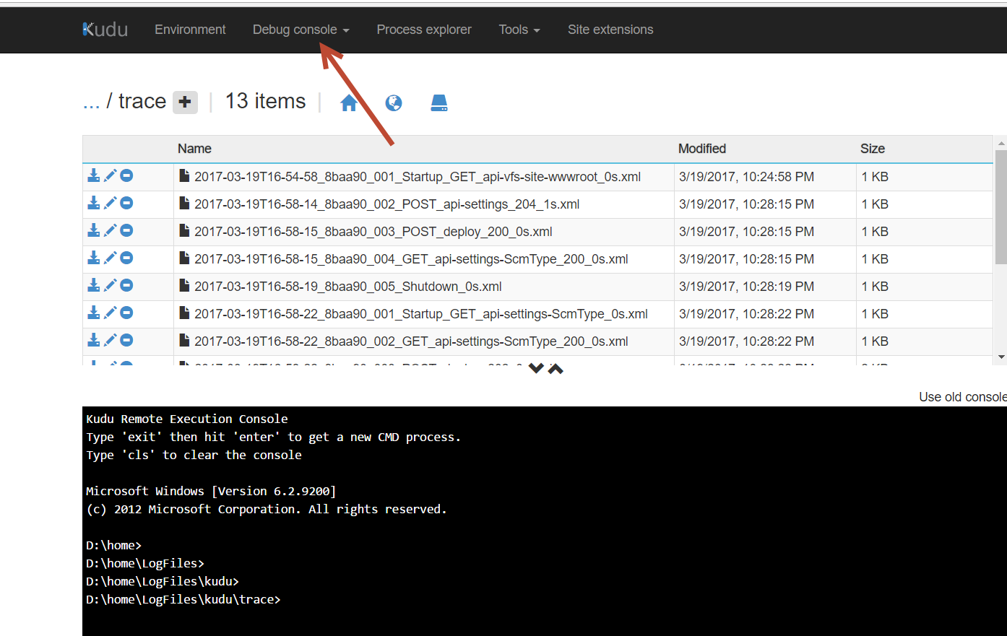

Slide 31
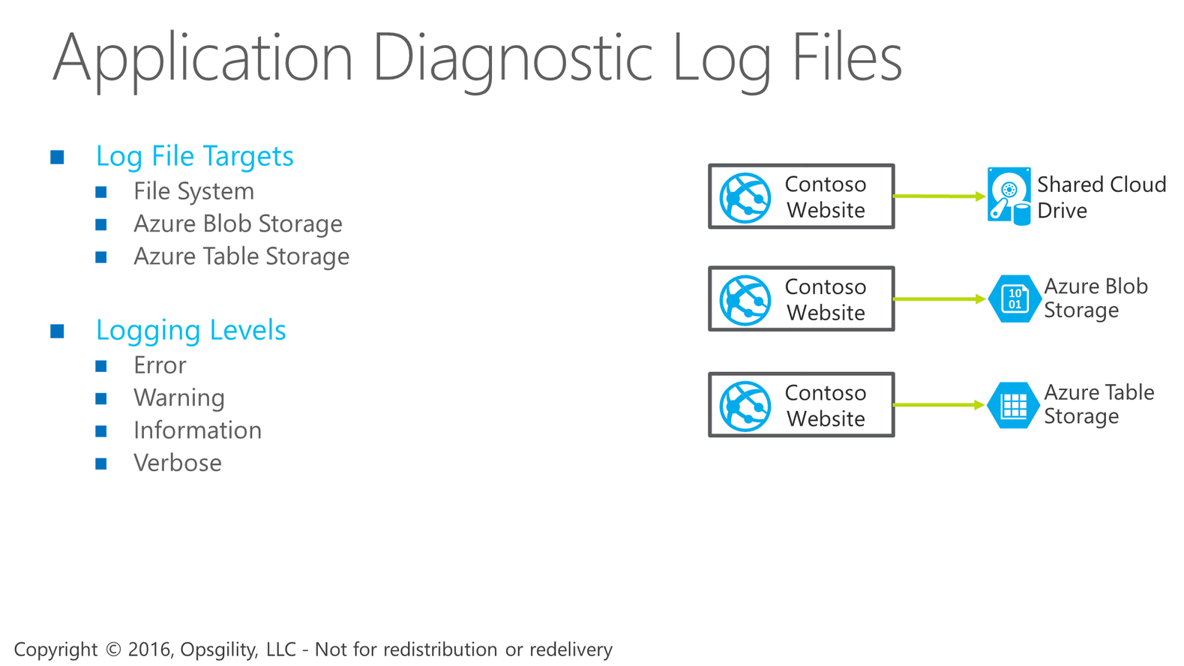

Application Diagnostic Log Files

Slide 32
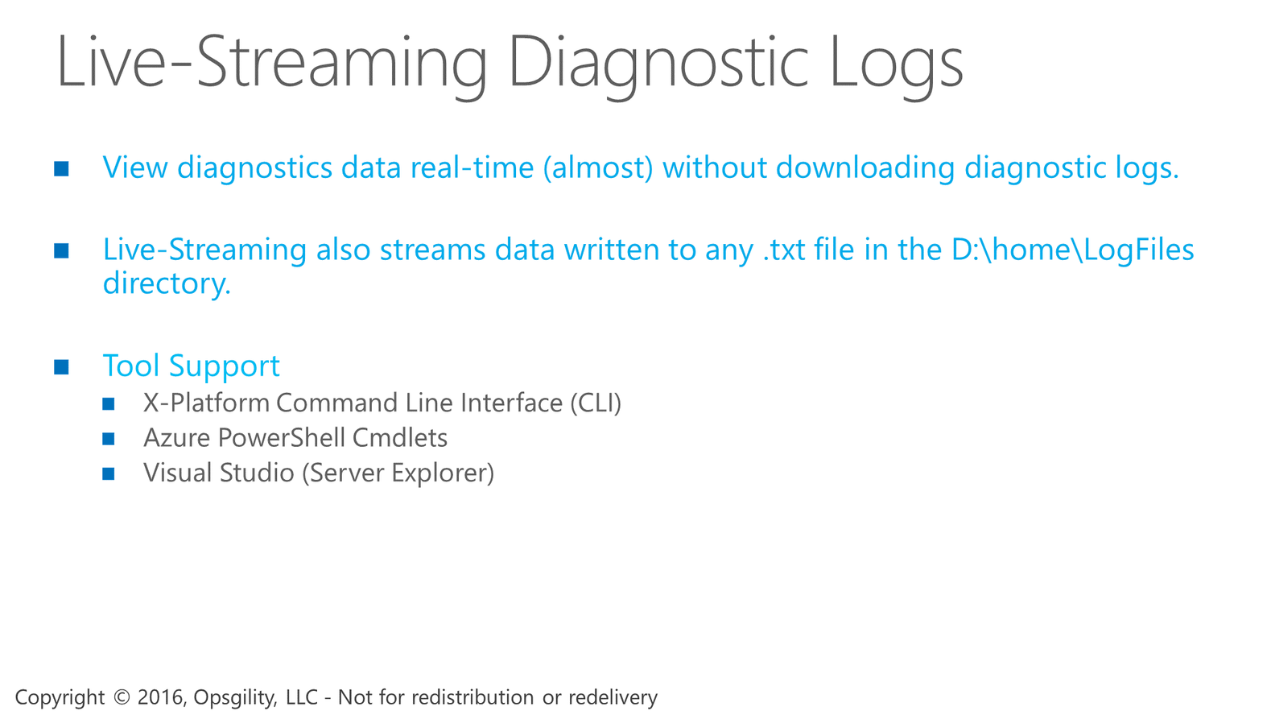
Live-Streaming Diagnostic Logs

Slide 33
Demo 4- performance test

Slide 34
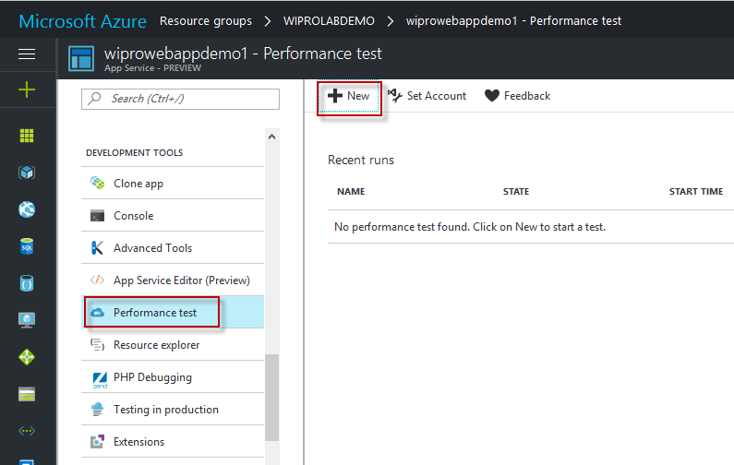

Slide 35
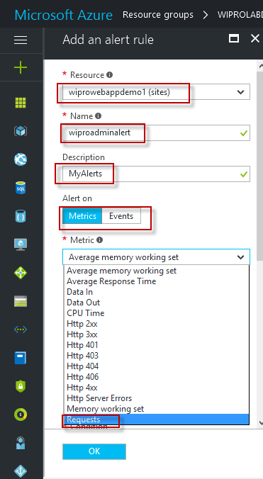
Demo 5- Alert
Notes:
Metric values - The alert triggers when the value of a specified metric crosses a threshold you assign in either direction. That is, it triggers both when the condition is first met and then afterwards when that condition is no longer being met.
Activity log events - An alert can trigger on every event, or, only when a certain number of events occur.

Slide 36
Demo 6- Scale out and Scale up

Slide 37
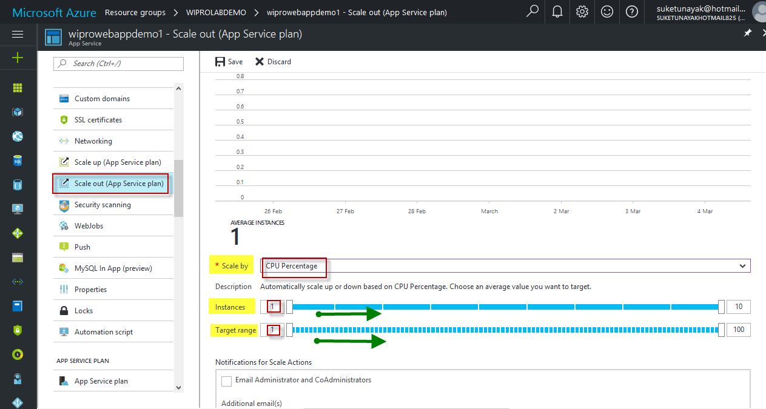

Slide 38
Demo 5- SSL and Domain Name (Video)

Slide 39
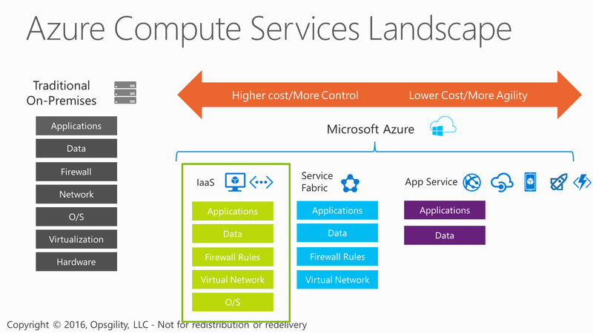
Azure Compute Services Landscape
Notes:
Notes
If you are new to cloud computing you will hear a lot of talk about different terms like Platform as a Service, Infrastructure as a Service, and Software as a Service.
Let me clarify what these terms and categories mean in more detail.
Infrastructure as a Service or IaaS – a set of infrastructure level capabilities such as an operating system, network connectivity, etc. that are delivered as pay for use services and can be used to host applications or server workloads. In Azure, virtual machines and virtual networks are the primary workloads with IaaS.
Platform as a Service or PaaS – higher level sets of functionality that are delivered as consumable services for developers who are building applications. PaaS is about abstracting developers from the underlying infrastructure to enable applications to quickly be composed. In Azure there are several PaaS services - such as Cloud Services, Service Fabric, App Service (Web Apps), Storage and SQL Database.
Software as a Service or SaaS – applications that are delivered using a service delivery model where organizations can simply consume and use the application. Typically an organization would pay for the use of the application or the application could be monetized through ad revenue. A great example of a SaaS based application is Office 365.

Slide 40


Enter Text
Thanks for Joining!!
Abdul Rasheed Feroz Khan
Feel free to reach me for any queries:
@TechFero | @CloudWorldTech
feroz@cwtechnologies.in

